Slide 1
Glassdoor Reviews Analysis – Competitor Data
By:
Surendra Dattatrey
People Analytics
December 3, 2019

Slide 2
Agenda
Executive Summary
Rating comparison
Analysis of S&P reviews
Comparative analysis of competitors
Comparison of top positive key attributes
Comparison of top negative key attributes
Appendix

Slide 3
Executive Summary
Objectives
Comparative analysis on text data of S&P.
We included data of competitors like – Bloomberg, CME, ICE, Moody’s, MSCI and Thomson Reuters.
Comparative analysis of top positive and negative keywords.
Review count given in below table –
We found out very common themes like- Work life balance, Work, Benefits, People, culture etc.
However there were few areas which S&P lagged compare to competitors like – fast paced environment, Health insurance, Work from home etc.
 | Review count
Bloomberg | 5,200
CME | 540
ICE | 332
Moody's | 789
MSCI | 620
S&P Global | 2,840
Thomson Reuters | 7,581

Slide 4
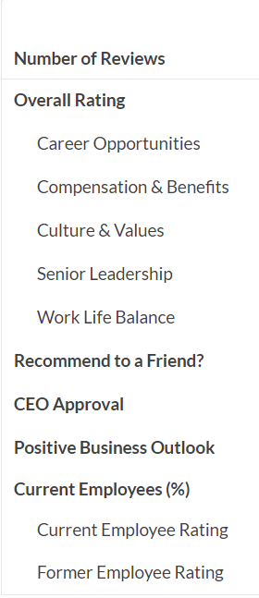
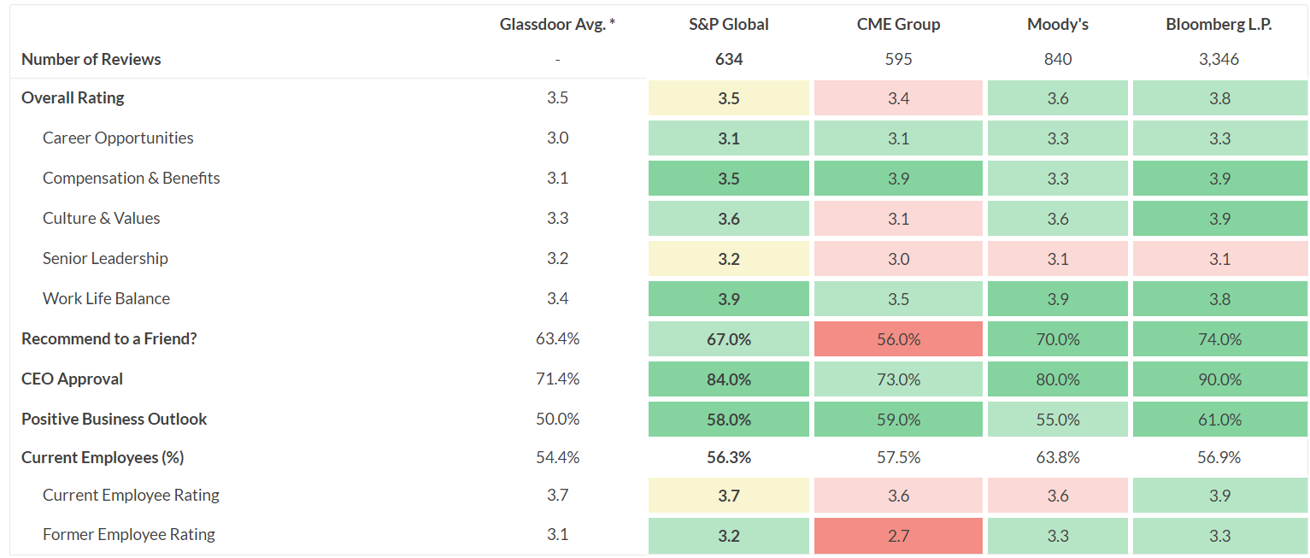
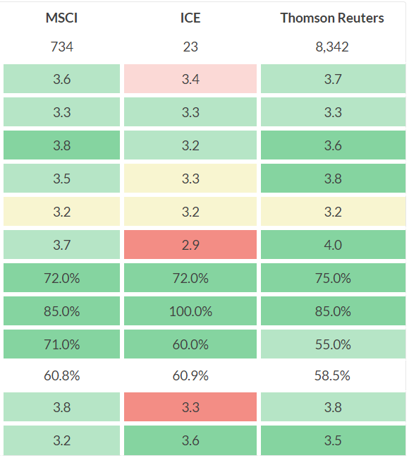
Rating comparison – Glassdoor
* This data is taken from Glassdoor comparison page. This is an average data, was last updated in January 2019.

Slide 5
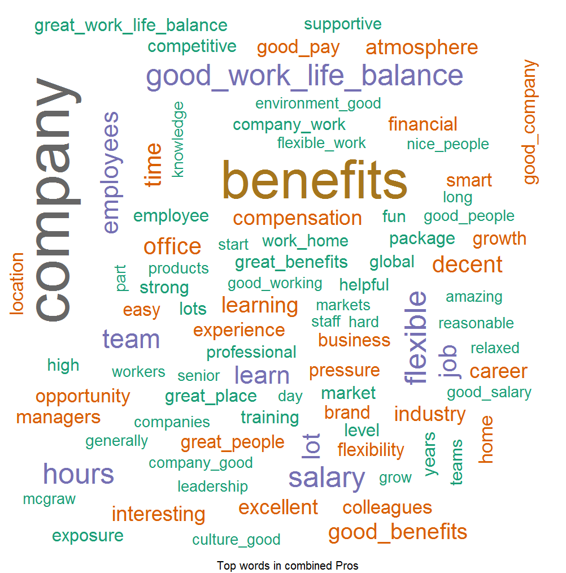
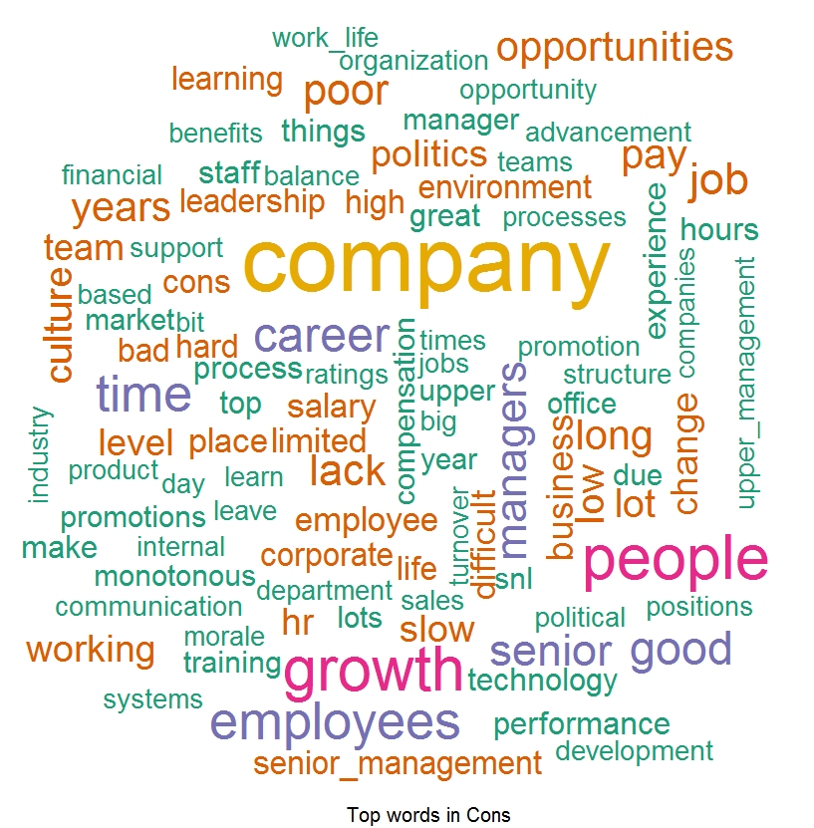
What employees saying about S&P
Pros: Things which Employees liked –
According to Employees feedback, we found out that people love our Good Benefits, Good Work Life Balance, Good Company, Good People and Opportunities provided by S&P and they are spreading good words on this front.
Cons: Word List which Employees don’t like –
Feedback provided by the Employees they found out to difficulty to cope up with Opportunities, Work Life, senior management, HR Processes , Monotonous Work , Growth , Promotions and Layoffs and this can be improved.

Slide 6
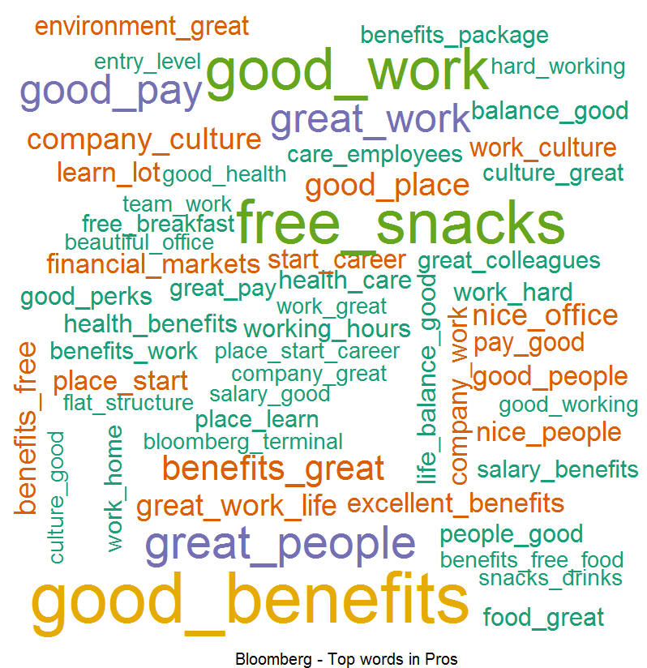
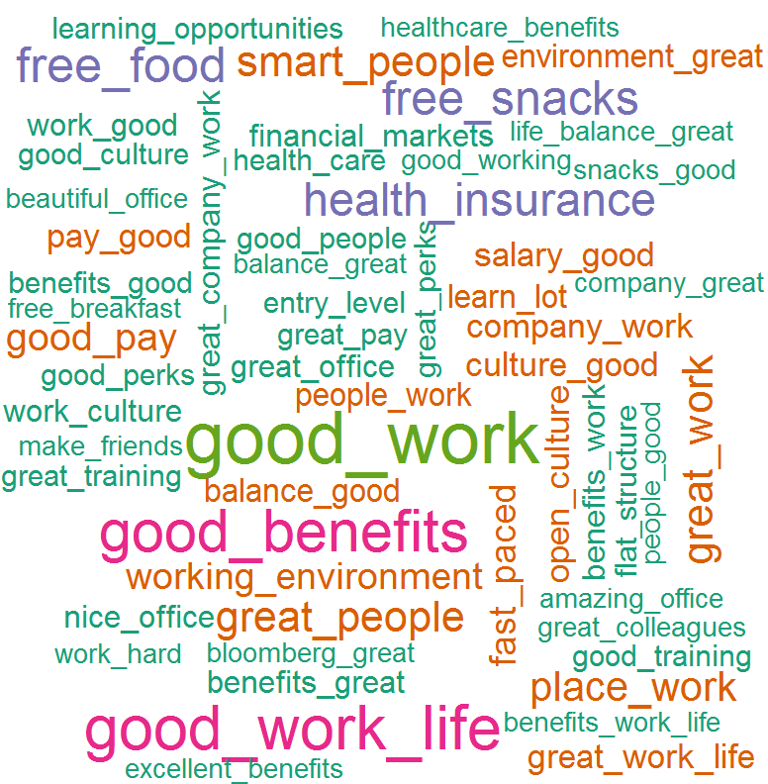
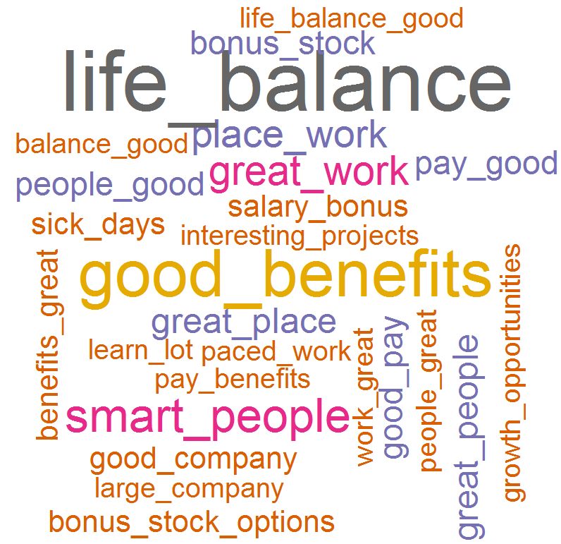
Comparative analysis with competitors
Bloomberg Pros:
CME Pros:
ICE Pros:
Most common Themes:
We found out most common theme in Bloomberg, CME and ICE were
Work life balance
Good work
Benefits
People
Culture
Free food / snacks
Health insurance
Top Keywords –
Free Food
Great Benefits
Work life balance
Free snacks
Good Work
Smart people
Work environment
Great place
Fast paced environment
Good pay
Top Keywords –
Work life balance
Great benefits
Good work
Great company
Free food
Great culture
Free snacks
Health insurance
Good salary
Great people
Good pay
Top Keywords –
Work life balance
Good benefits
Good work
Fast paced environment
Smart people
Work environment
Stock options
Good people
Good compensation
Cutting edge technology
Great place
Good pay

Slide 7
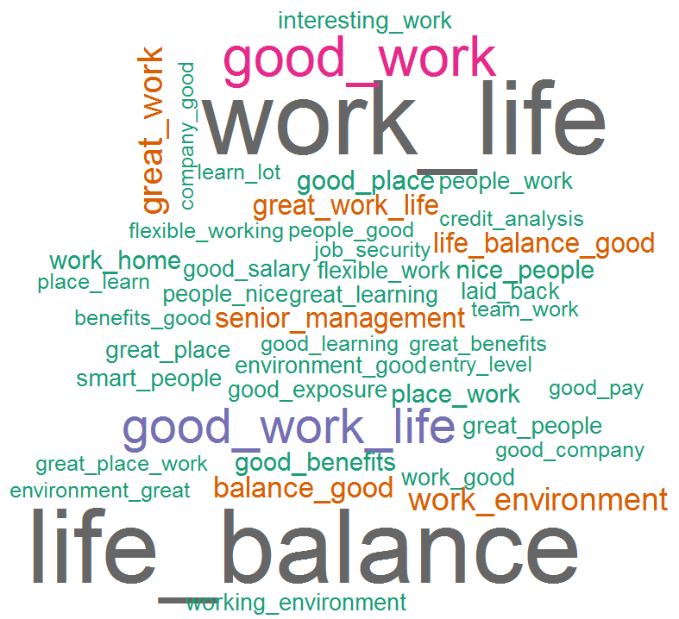
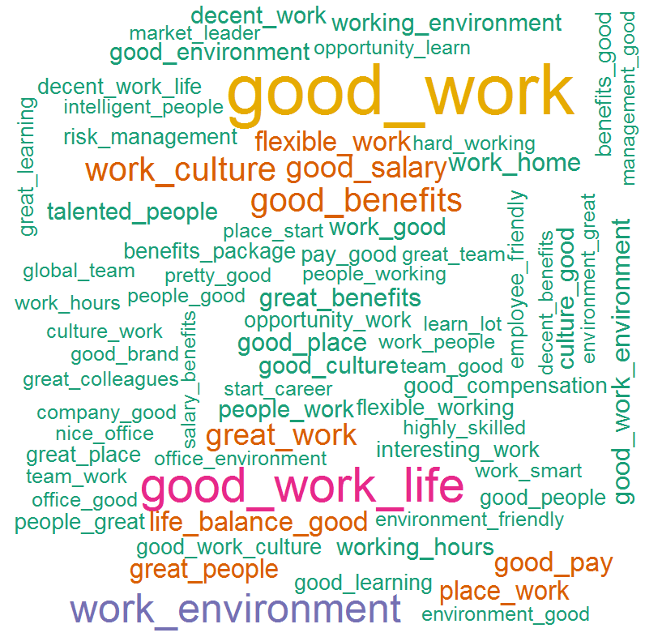
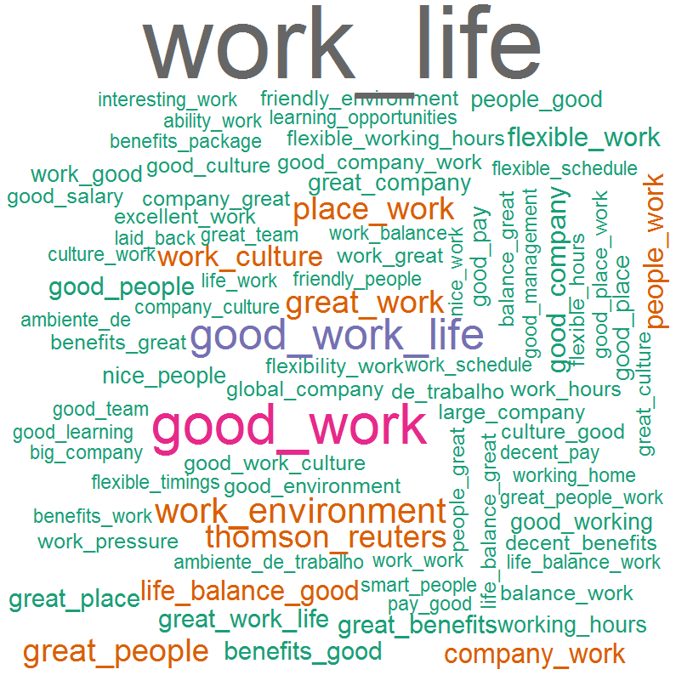
Comparative analysis with competitors
Moody’s Pros:
MSCI Pros:
Thomson Reuters Pros:
Most common Themes:
We found out most common theme in Bloomberg, CME and ICE were
Work life balance
Good work
Benefits
People
Culture
Work environment
Top Keywords –
Work life balance
Good Work
Work environment
Senior management
Good place
Good benefits
Nice people
Work from home
Smart people
Interesting / flexible work
Good salary
Top Keywords –
Work life balance
Work environment
Good benefits
Work culture
Smart people
Great work
Good salary
Flexible work
Work from home
Working hours
Good culture
Talented people
Top Keywords –
Work life balance
Good work
Good benefits
Work environment
Great people
Work from home
Work culture
Flexible working
Employee friendly
Flexible hours
Work pressure
Friendly environment

Slide 8
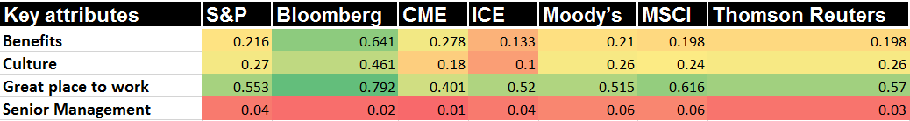
Comparison of top positive key groups
Key attributes consists of –
Benefits – Benefits, Health insurance, Salary/pay, Free food / snacks, Work from home, working hours
Culture – Culture, Flexibility, work life balance, employee friendly
Great place to work – Great place to work, Work, work environment, fast paced environment, cutting edge technology, people
Senior management – Leadership and Senior management

Slide 9
Appendix

Slide 10
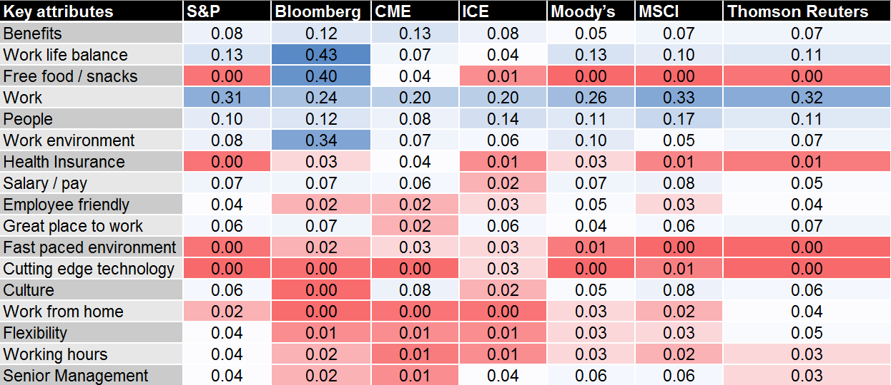
Comparison of top positive key attributes (Word proportions out of 1)

Slide 11
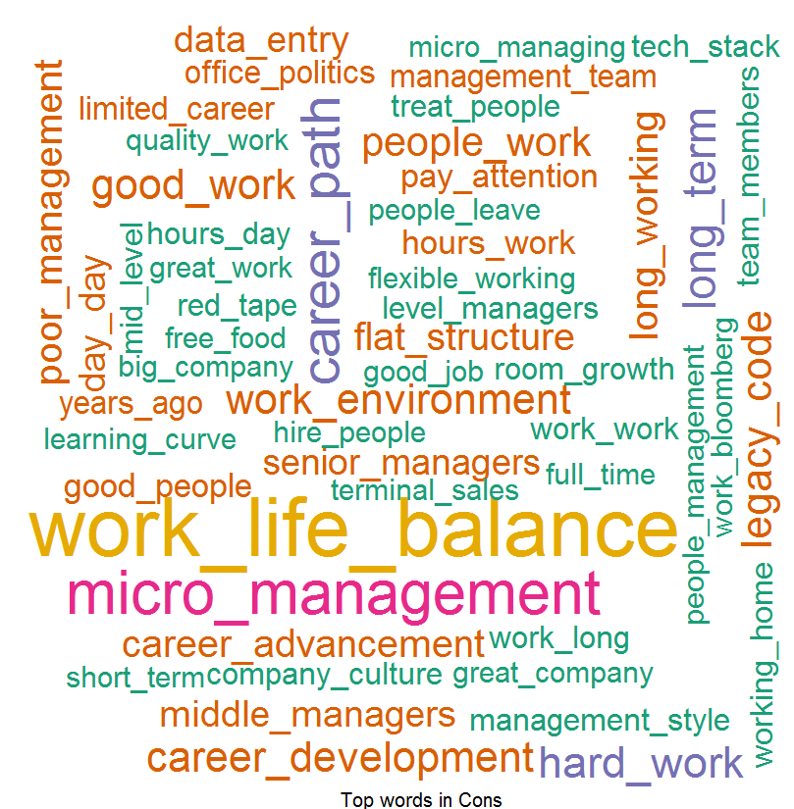
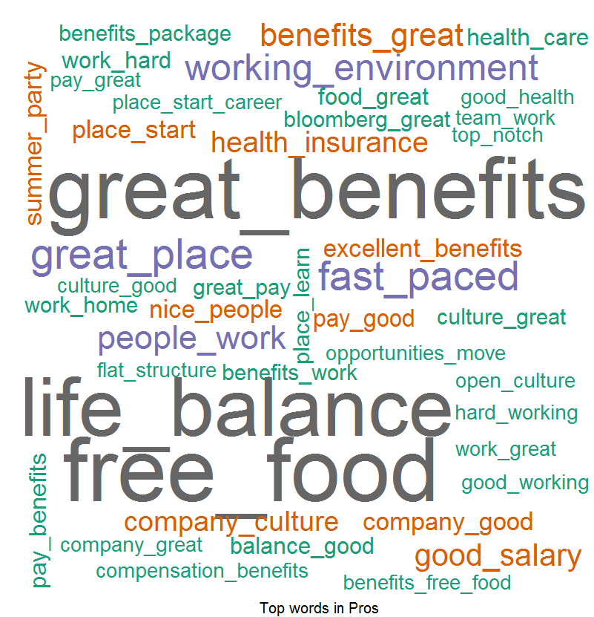
Overall Word Cloud For Pros and Cons – For Bloomberg
Word Cloud for Pros
Word Cloud for Cons
Good Words List –
Free food
Great Benefits
Work Life Balance
Free snacks
Good Work
Smart people
Word List which people don’t like –
Long hours
Work life balance
Middle management
Team leaders
Working hours
Micro Management
Career Progression

Slide 12
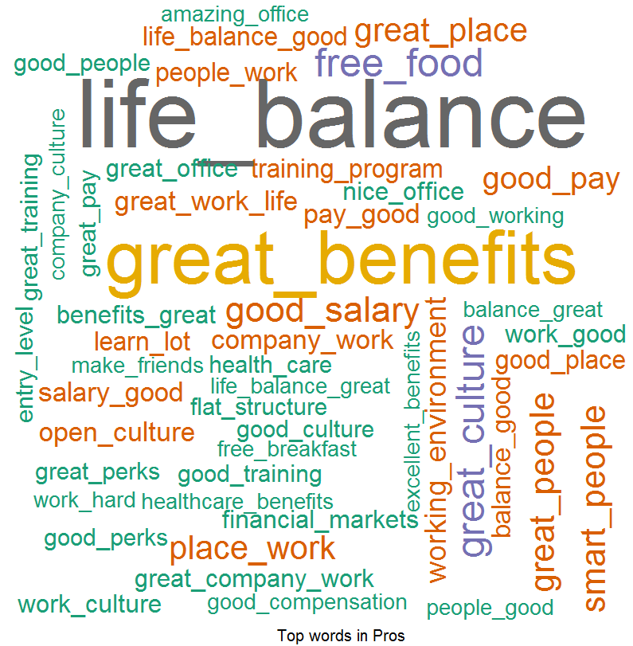
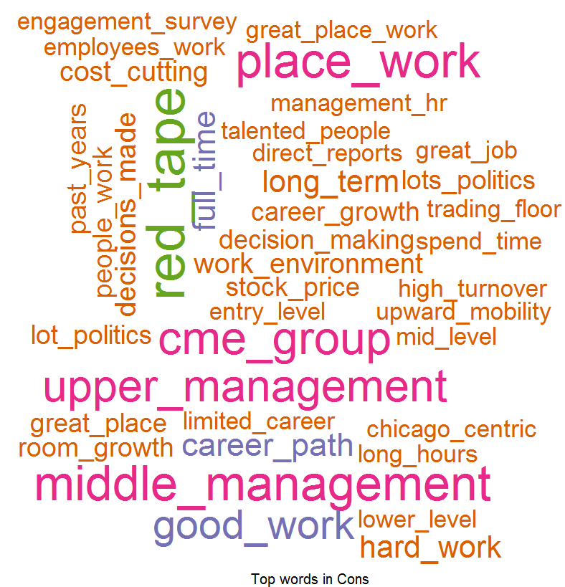
Overall Word Cloud for Pros and Cons – FOR CME
Word Cloud for Pros
Word Cloud for Cons
Good Words List –
Work life balance
Great Benefits
Good work
Free food
Great Culture
Health insurance
Word List which people don’t like –
Senior management
Work life balance
Red tape
Middle management
Upper management
Career path
Career advancement
Lots of politics

Slide 13
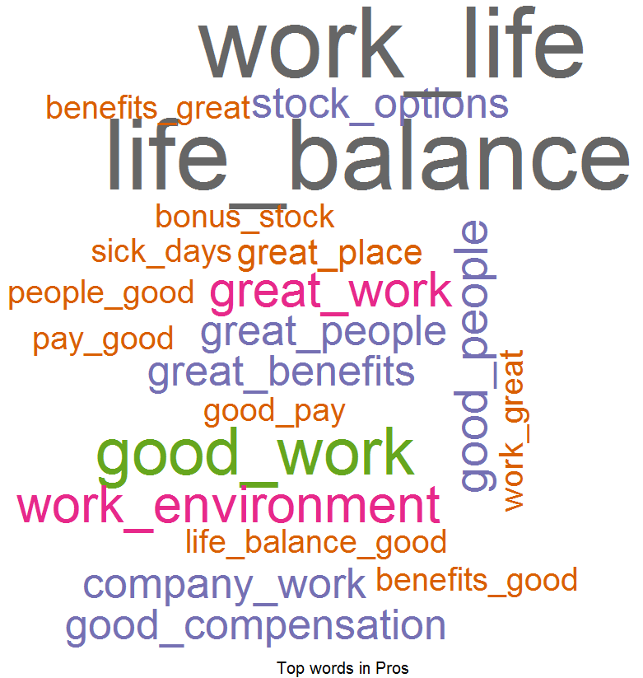
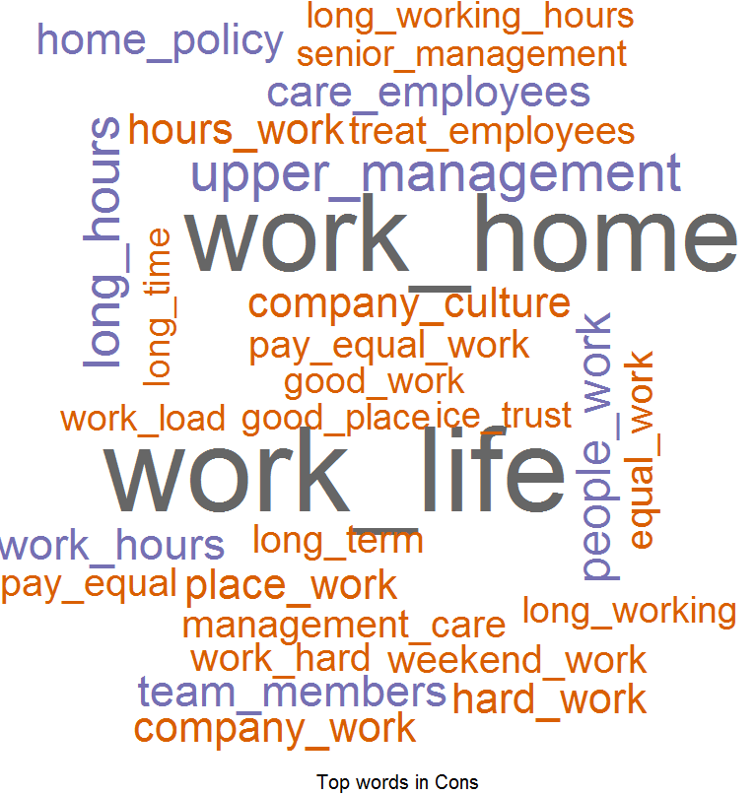
Overall Word Cloud for Pros and Cons - ICE
Word Cloud for Pros
Word Cloud for Cons
Good Words List –
Work life balance
Good benefits
Good work
Fast passed work environment
Good people
Stock options
Word List which people don’t like –
Work life balance
Work from home policy
Upper management
Long hours
Working hours
Career growth
Care for employees
Hard work

Slide 14
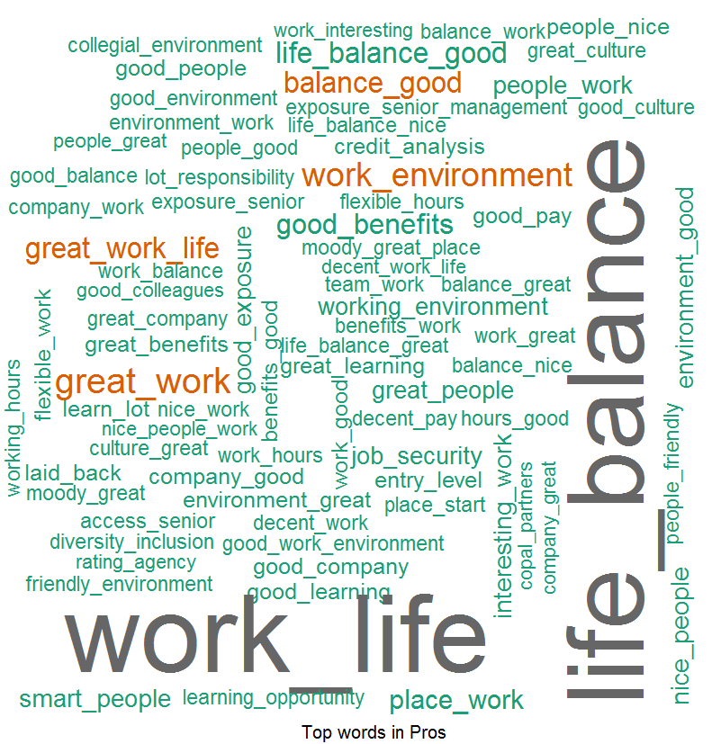
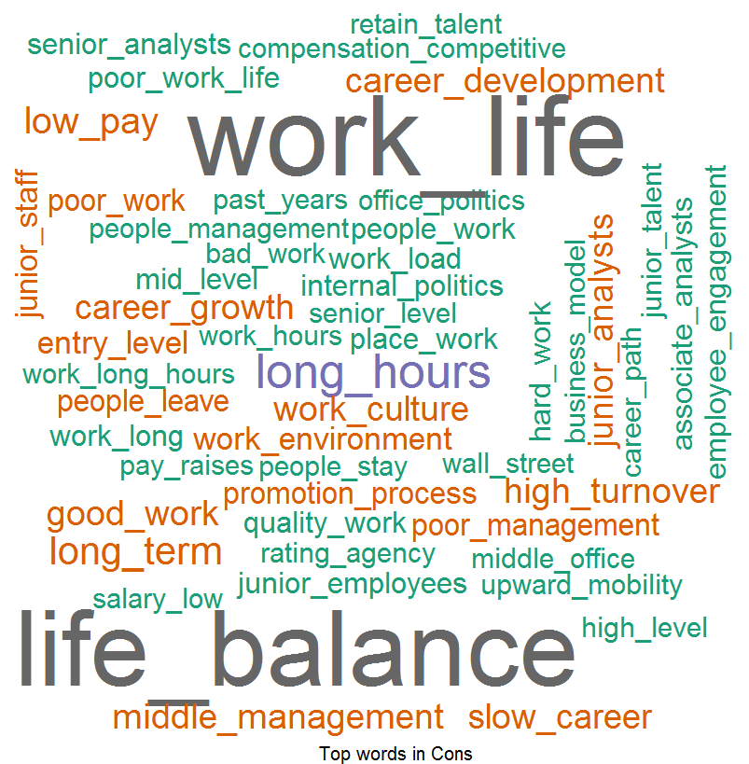
Overall Word Cloud for Pros and Cons – Moody’s
Word Cloud for Pros
Word Cloud for Cons
Good Words List –
Work life balance
Good work
Work environment
Senior management
Good place to work
Good benefits
Word List which people don’t like –
Work life balance
Senior management
Long working hours
Career progression
Low pay
Middle management
High turnover
Work culture

Slide 15
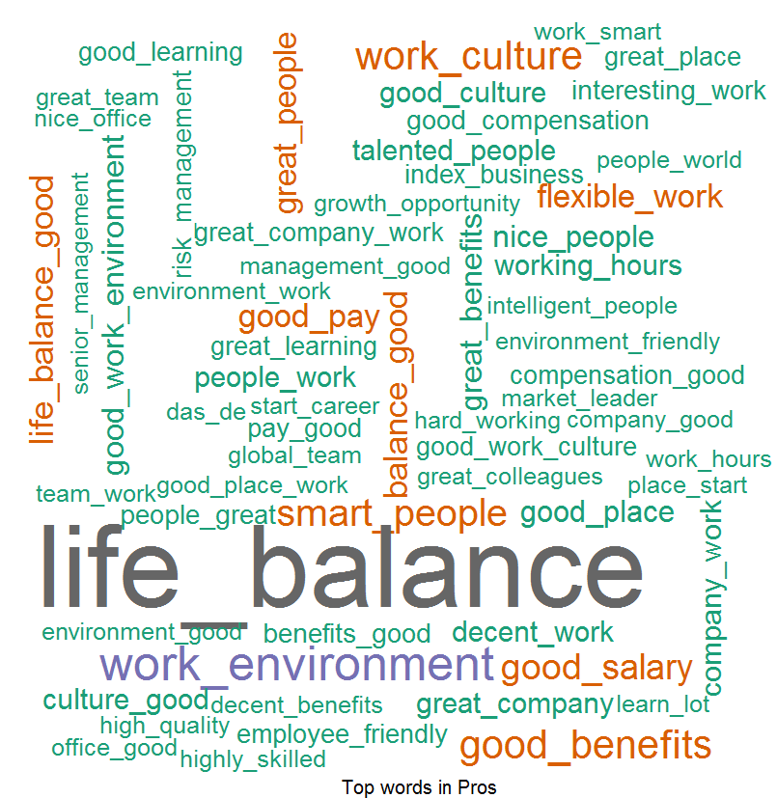
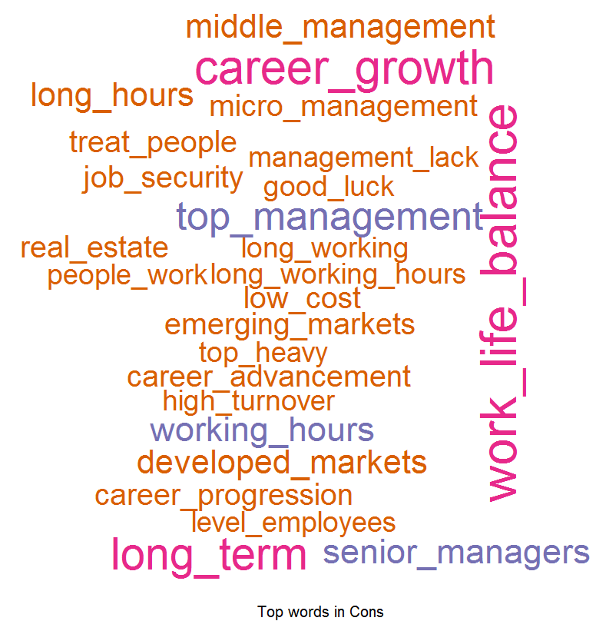
Overall Word Cloud for Pros and Cons – MSCI
Word Cloud for Pros
Word Cloud for Cons
Good Words List –
Work life balance
Good work
Work environment
Good benefits
Work culture
Smart people
Word List which people don’t like –
Senior management
Cost Cutting
Career development
Work life balance
Career growth
High turnover
Work culture

Slide 16
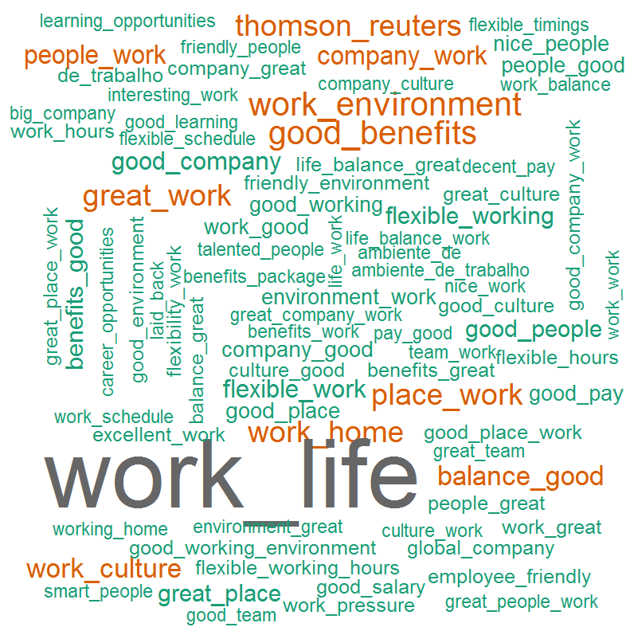
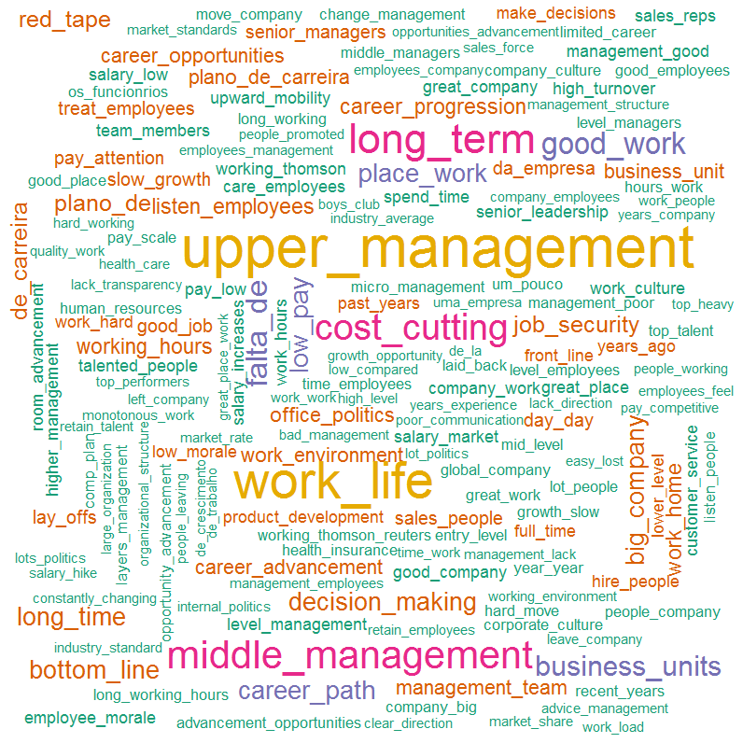
Overall Word Cloud for Pros and Cons – Thomson Reuters
Word Cloud for Pros
Word Cloud for Cons
Good Words List –
Work life balance
Good work
Good benefits
Work environment
Great people
Work from home
Word List which people don’t like –
Senior / upper management
Work life balance
Career growth
Work life balance
Cost cutting
Career path
Low pay
Decision making

